Slide 1

Sir CR Reddy College Of Engineering Department Of Computer Science Diagnostic Methods For Brain Disease Using Machine Learning And Deep Learning: Principles And Recent Advances
Under the Guidance of:
G.Monika Devi, M.Tech
Assistant Professor, CSE
Team Members:
V.Karthikeya(20B81A05I6) Y.LalithNivas(20B81A05I7) Y.Nava Chaitanya(20B81A05I8) Y.HemaSri(20B81A05I9) Y.Harshitha (20B81A05J0)

Slide 2
Agenda
Abstract
Problem Statement
Existing System
Drawbacks of Existing System
Proposed System
System Architecture
Algorithms
Implementation
Result

Slide 3
Abstract
The Brain, Our Body's Control Center, Faces Increasing Challenges With The Discovery Of New Diseases. Diagnosing These Conditions Is Complex, Posing An Ongoing Research Problem. Early Detection Is Crucial For Effective Treatment. Artificial Intelligence (AI) Has Revolutionized Neurology, Enhancing Accuracy In Brain Disease Prediction And Detection. This Study Reviews Recent Machine Learning And Deep Learning Approaches, Focusing On Advanced Imaging And Real-time Monitoring. This Project focus on prediction of brain diseases like brain tumors, Alzheimer's disease, Parkinson's disease, and epilepsy

Slide 4
Problem Statement
The problem statement revolves around optimizing the diagnostic process by consolidating the datasets and developing a unified model capable of accurately predicting the presence of each of the four diseases while mitigating the drawbacks associated with using separate datasets.
The system aims to address the challenge of accurately diagnosing brain tumor, Alzheimer's disease, Parkinson's disease, and epilepsy using machine learning and deep learning algorithms.

Slide 5
Existing System
Existing system uses various machine learning and deep learning algorithms to train for different diseases like brain tumor, Alzheimer's, Parkinson's, and epilepsy can help ensure accurate diagnosis.
Utilizing a range of machine learning and deep learning algorithms in the current system enhances diagnostic accuracy for diverse conditions such as brain tumors, Alzheimer's, Parkinson's, and epilepsy.
By employing separate datasets for training each disease, the system can effectively capture the distinct characteristics and patterns associated with each condition, thereby improving the precision of diagnosis and treatment recommendations tailored to individual diseases.

Slide 6
Drawbacks of Existing System
ML and DL techniques which are used in existing system, are typically application-specific where a model trained for detecting one kind of brain disorder might not work well for another brain disorder.
That means the algorithm is designed to train the specific disease which makes it difficult to predict other disease.

Slide 7
Proposed System
In the proposed system, we'll gather images of all four diseases into a single dataset, enabling the model to be trained on this consolidated dataset.
By training the model on a combined dataset, it can learn to distinguish between the different diseases and make predictions accordingly.
This unified approach can potentially improve the model's ability to generalize and make accurate predictions across multiple conditions.

Slide 8
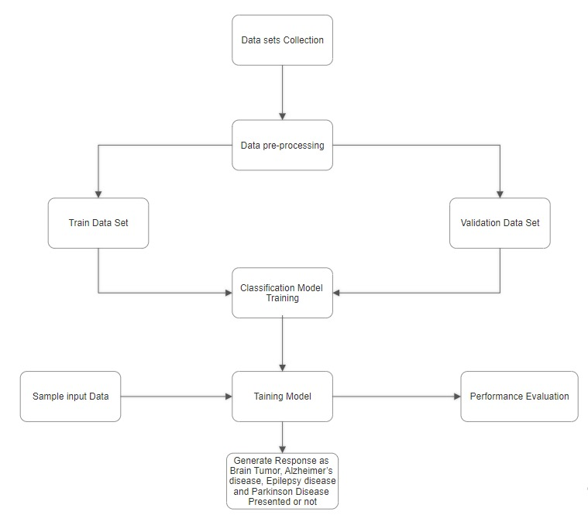
System Architecture

Slide 9
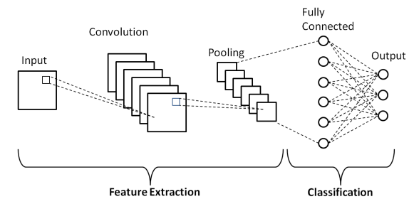
ALGORITHMS
CONVOLUTIONAL NEURAL NETWORK
Cnn a type of deep learning algorithm commonly used for tasks involving images, such as image classification, object detection, and image segmentation. These layers learn to detect patterns and features at different levels of abstraction, starting from simple edges and textures to more complex shapes and objects.
EfficientNetB0 is a convolutional neural network architecture introduced by researchers at Google. It performs feature extraction by using convolutional layers to extract hierarchical representations of input images.

Slide 10
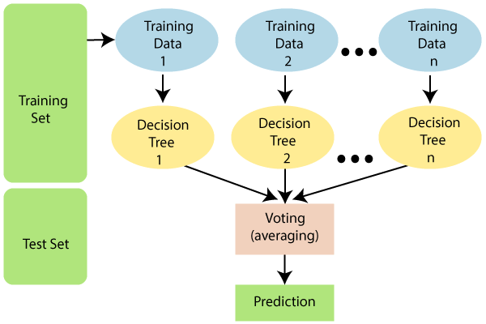
RANDOM FOREST
Random Forest is a versatile machine learning algorithm that works by constructing a multitude of decision trees during training. Each tree is built using a random subset of the training data and a random subset of features at each node.
During prediction, the Random Forest aggregates the predictions of all the individual trees. For classification tasks, it uses voting to determine the final class, while for regression tasks, it averages the predictions of all the trees to obtain the final output.

Slide 11

SUPPORT VECTIOR MACHINE
A Support Vector Machine (SVM) is a powerful supervised learning algorithm used for classification and regression tasks. It works by finding the optimal hyperplane that best separates the different classes in the input feature space. They are widely used in various applications such as text classification, image recognition, and bioinformatics.

Slide 12
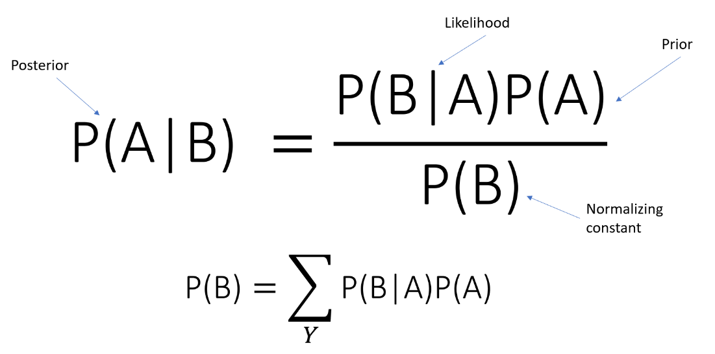
NAIVE BAYES THEOREM
Naive Bayes is a simple yet powerful probabilistic classifier based on Bayes' theorem with the "naive" assumption of feature independence. It's commonly used for classification tasks, particularly in text categorization, spam filtering, and sentiment analysis.

Slide 13
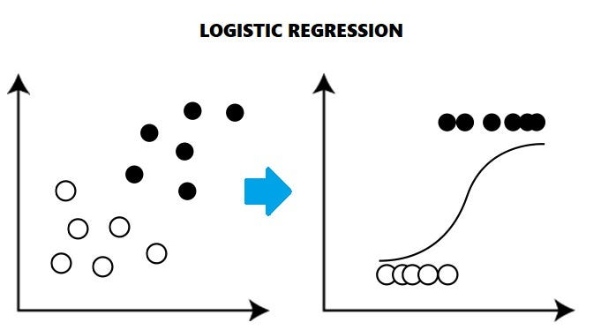
LOGISTIC REGRESSION
Logistic regression is one of the most popular Machine Learning algorithms, which comes under the Supervised Learning technique. It is used for predicting the categorical dependent variable using a given set of independent variables.

Slide 14
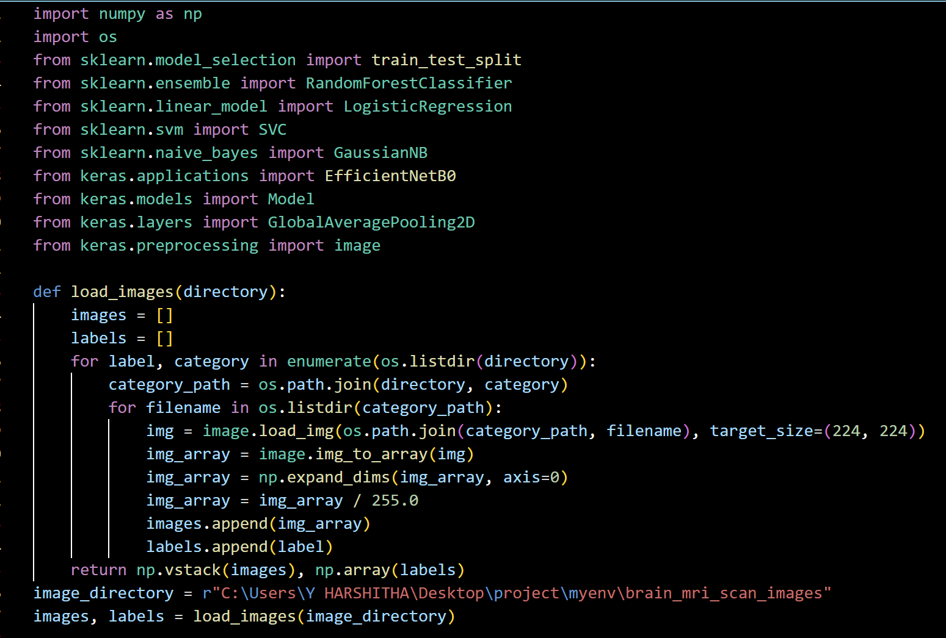
Implementation

Slide 15
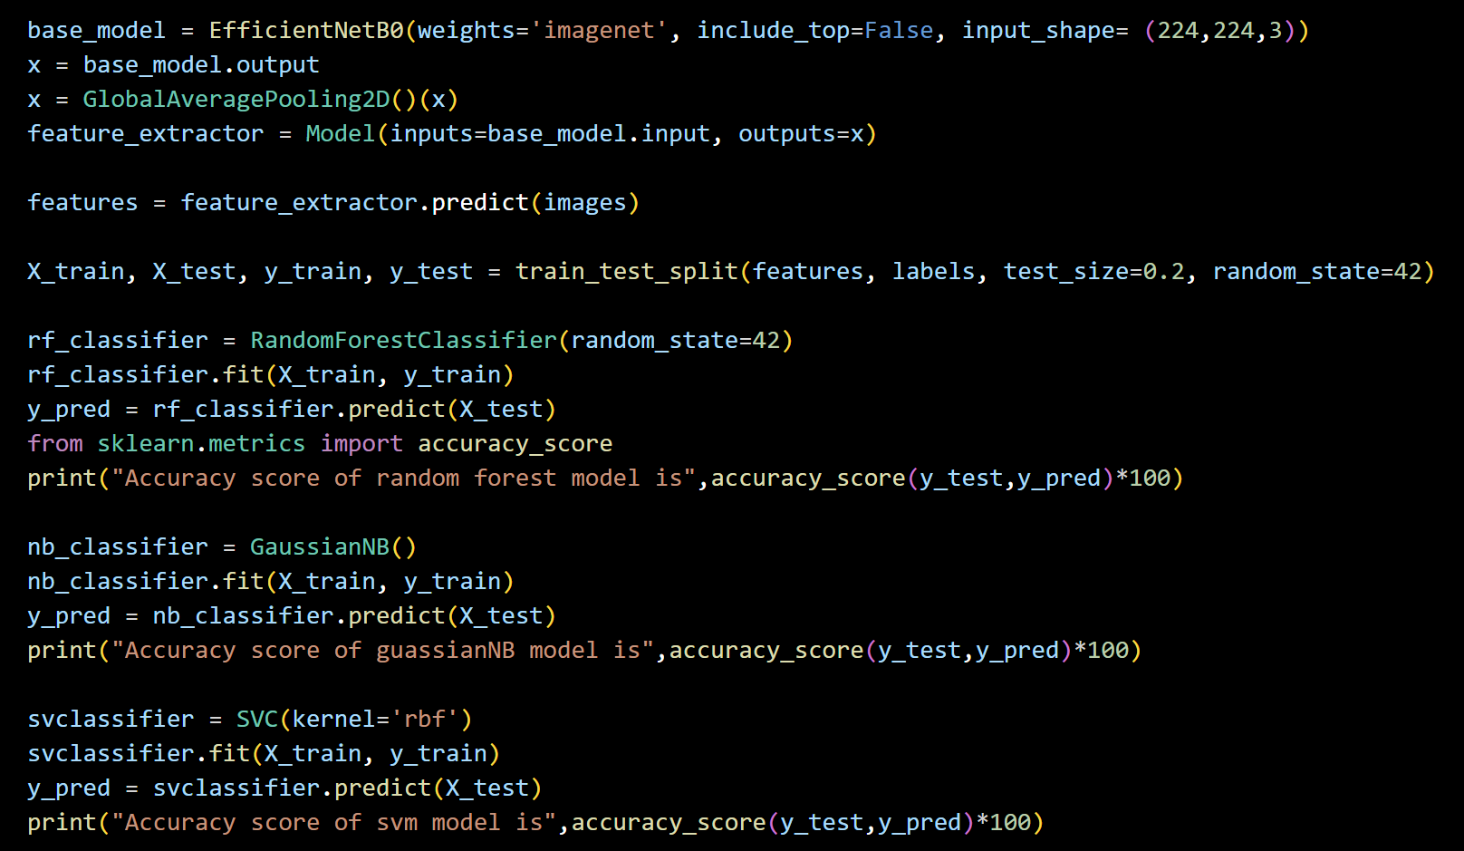

Slide 16
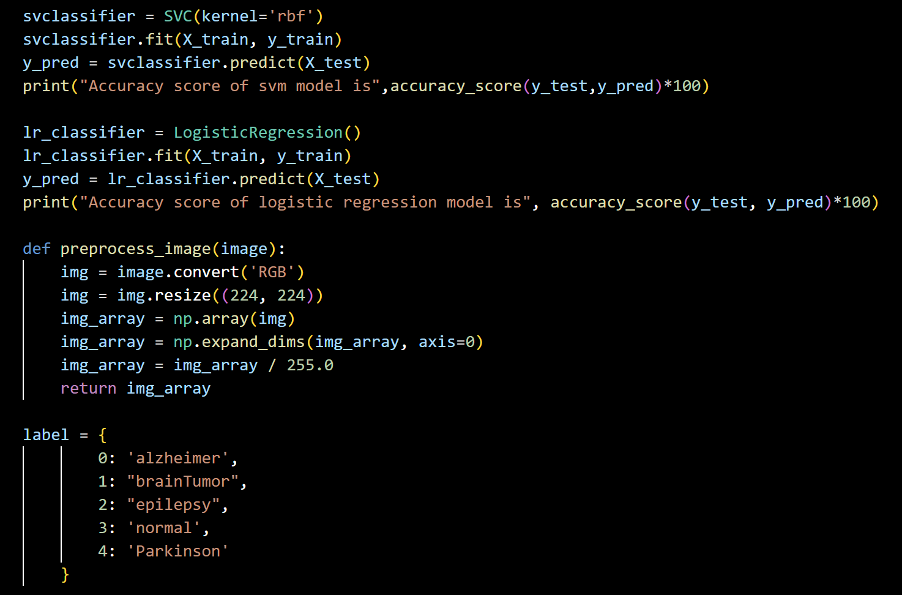

Slide 17
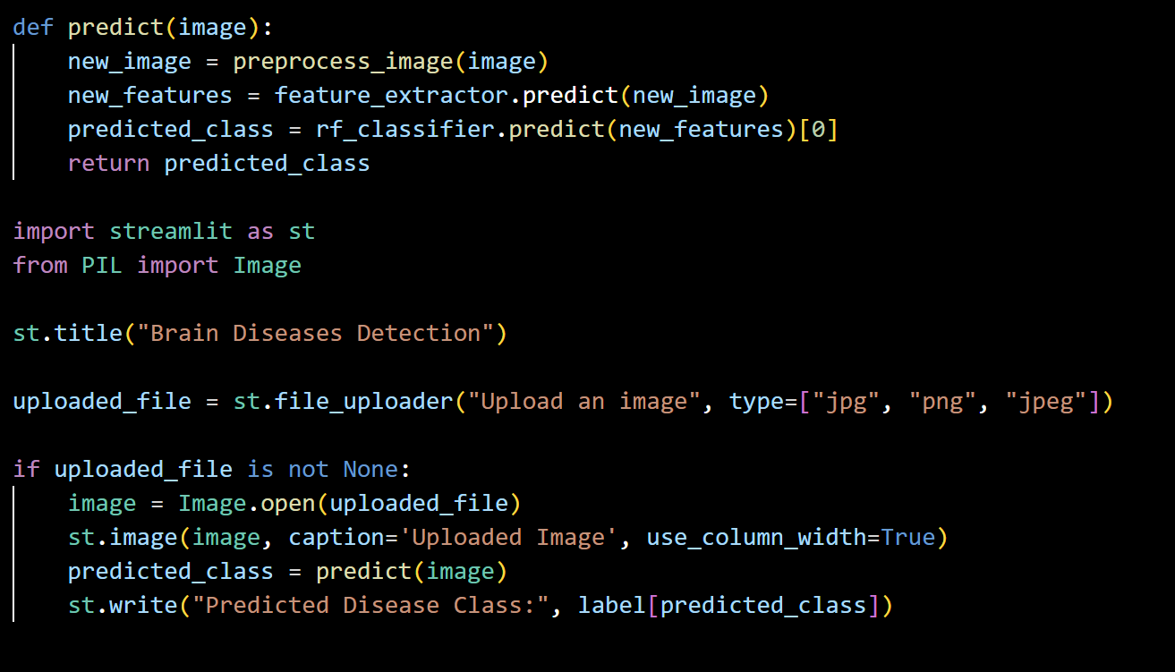

Slide 18
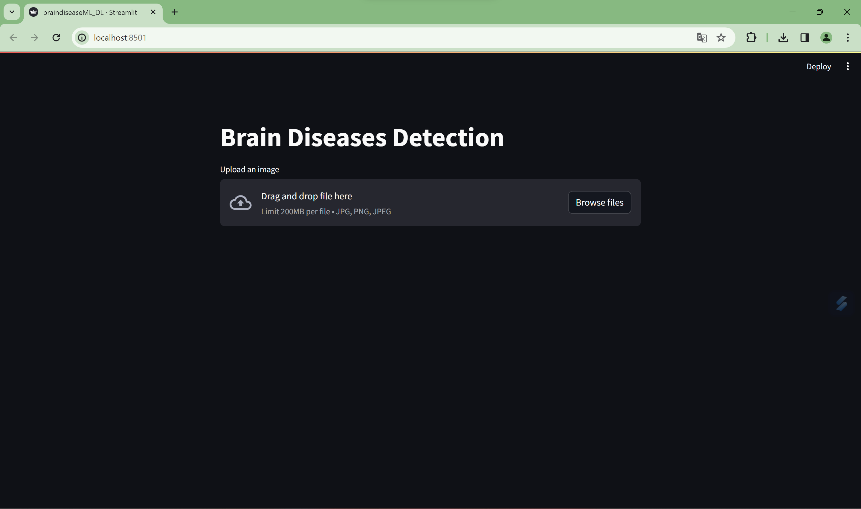
Web Interface

Slide 19
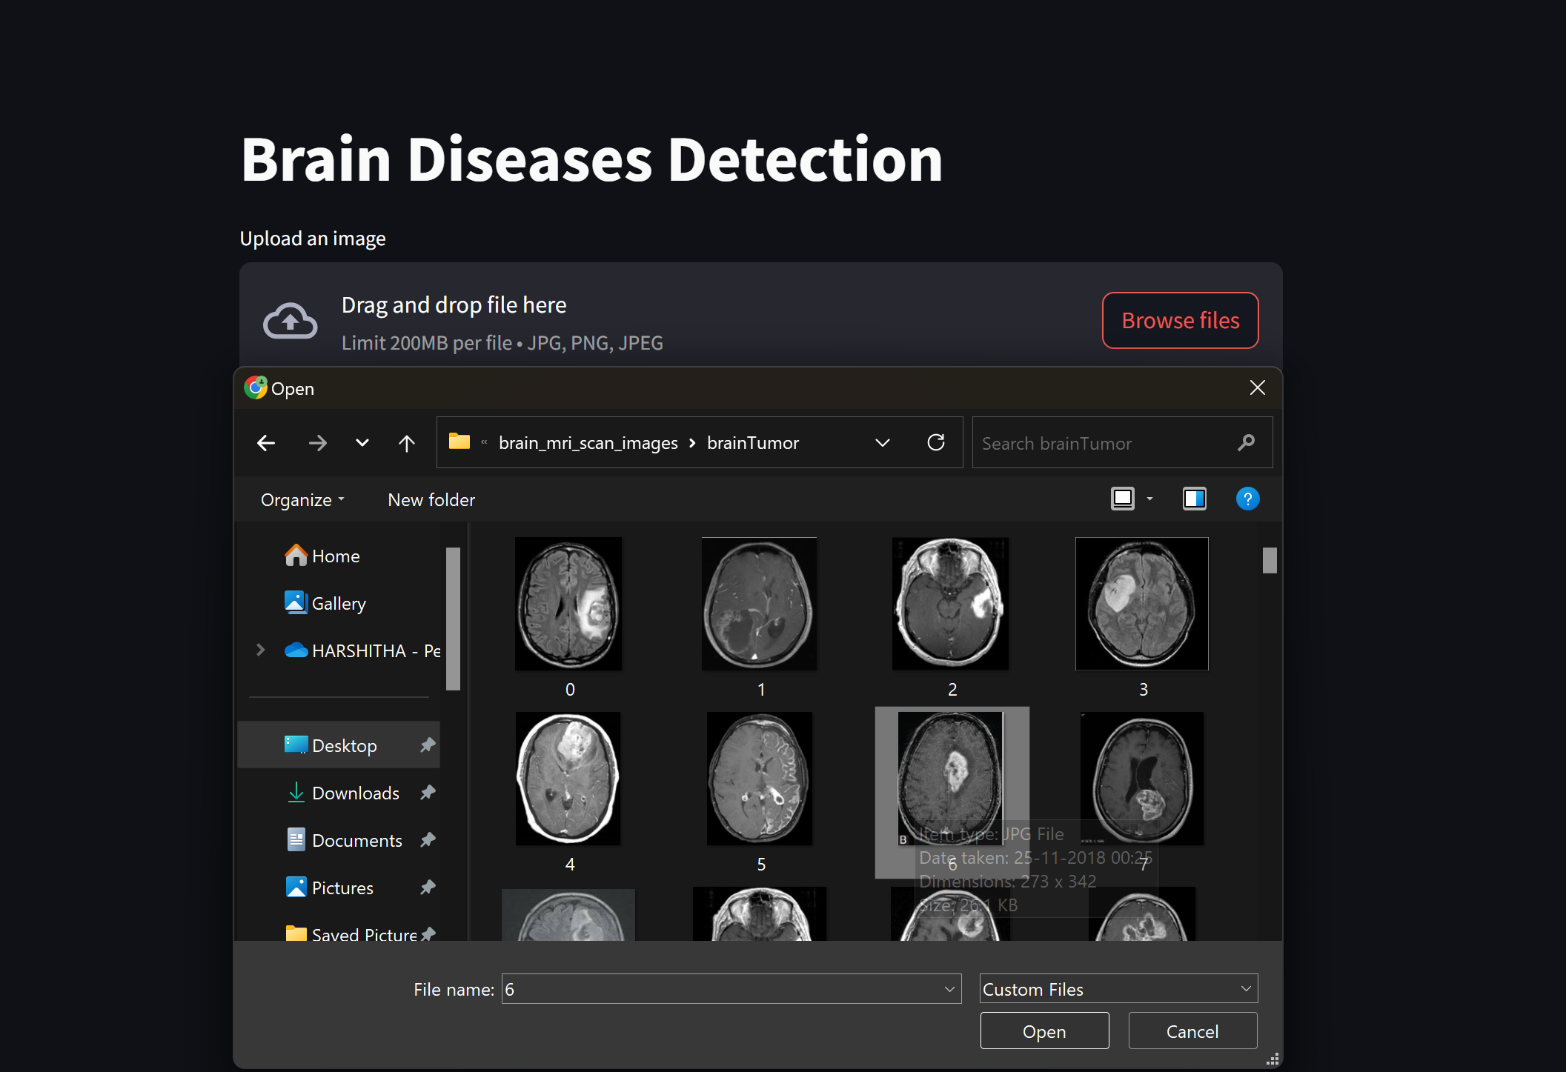
INPUT

Slide 20
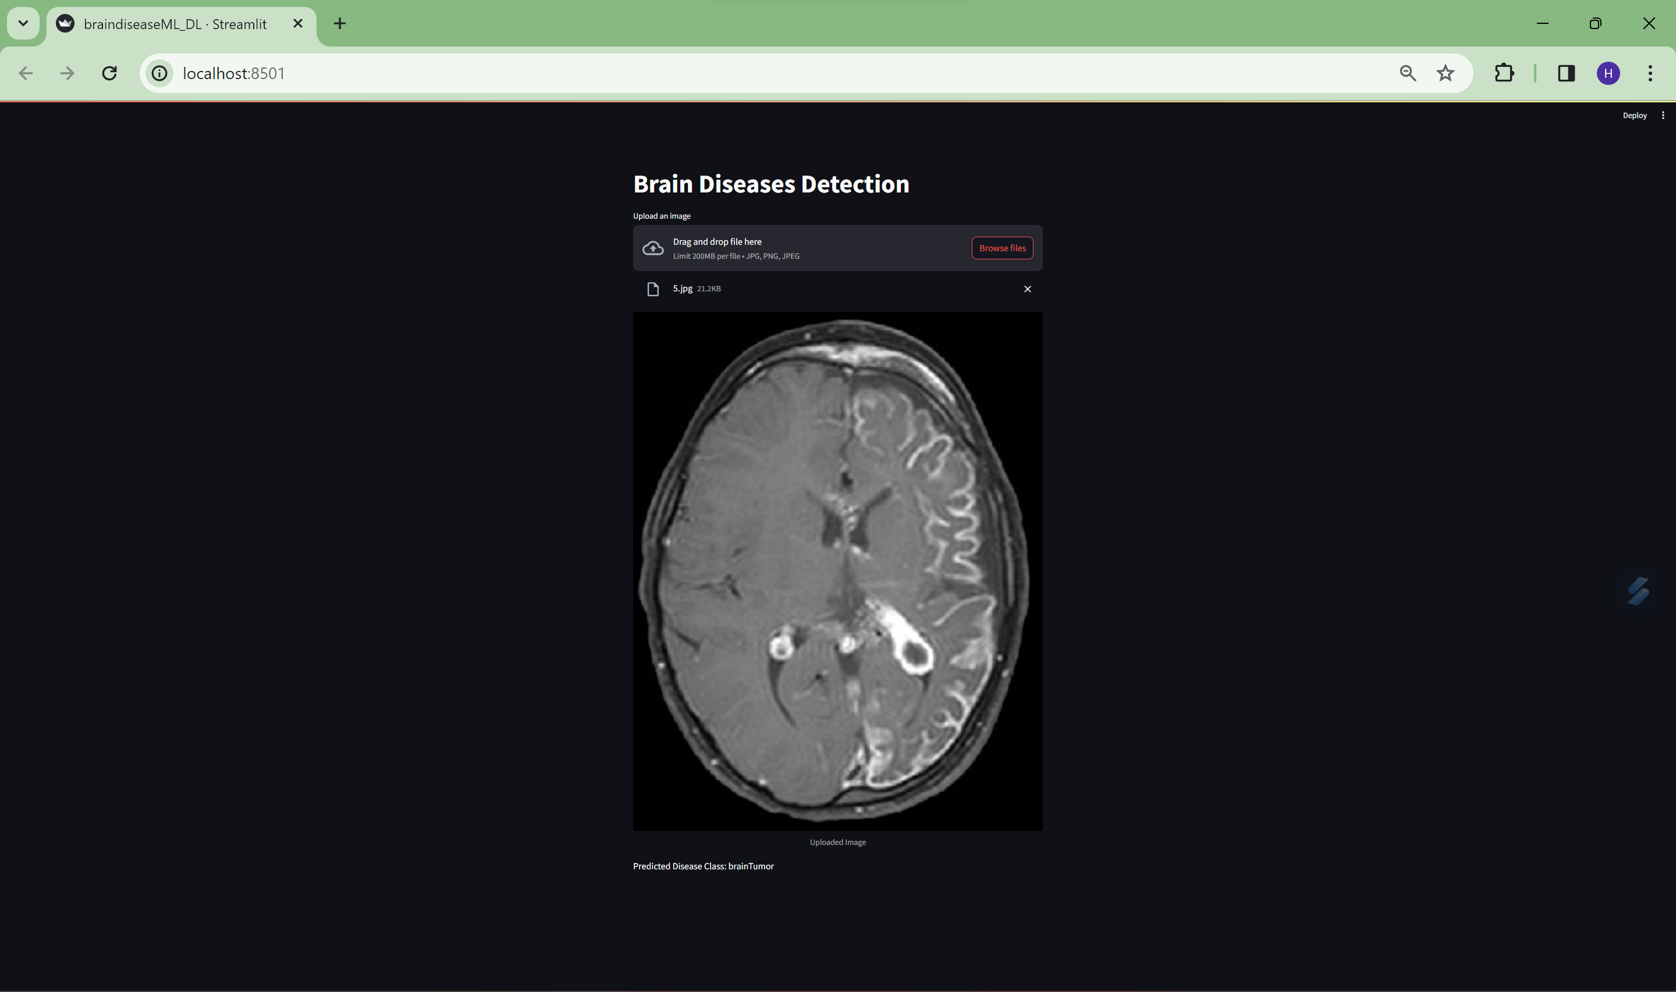
OUTPUT

Slide 21
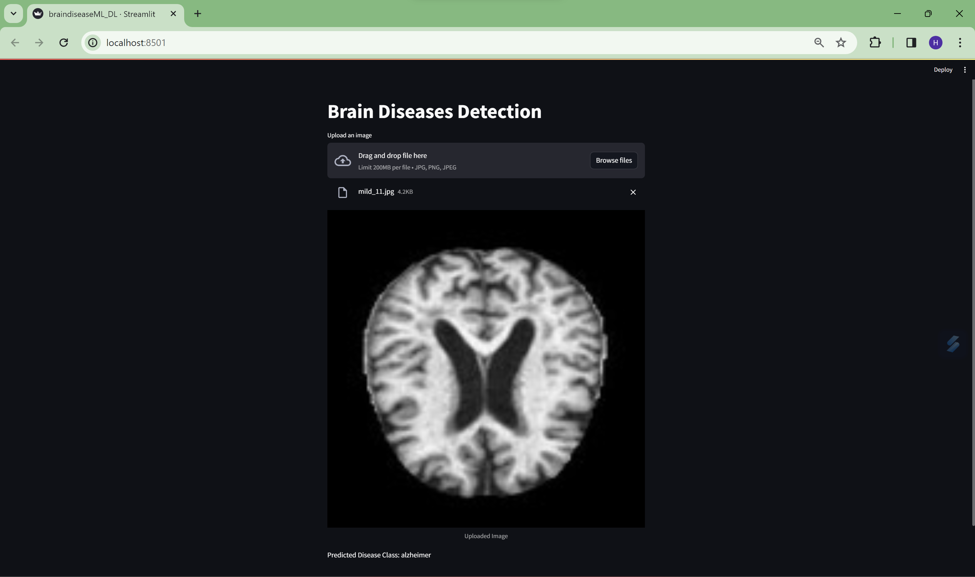
OUTPUT

Slide 22
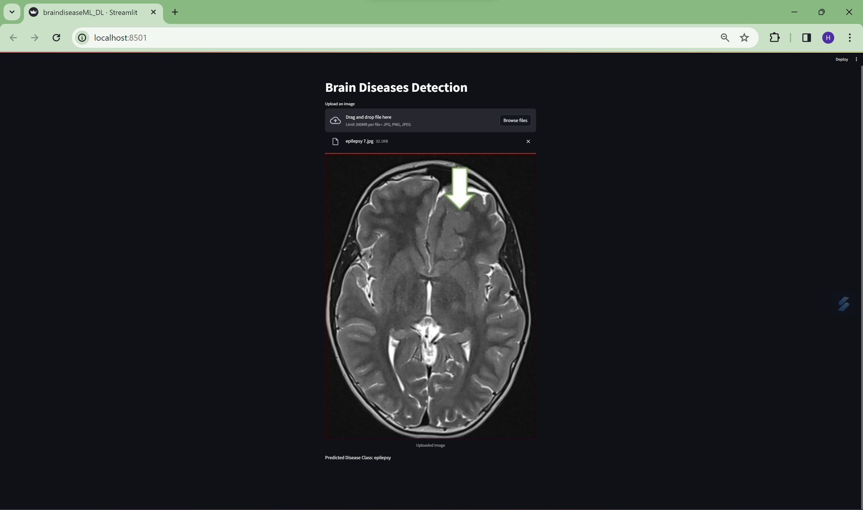
OUTPUT

Slide 23
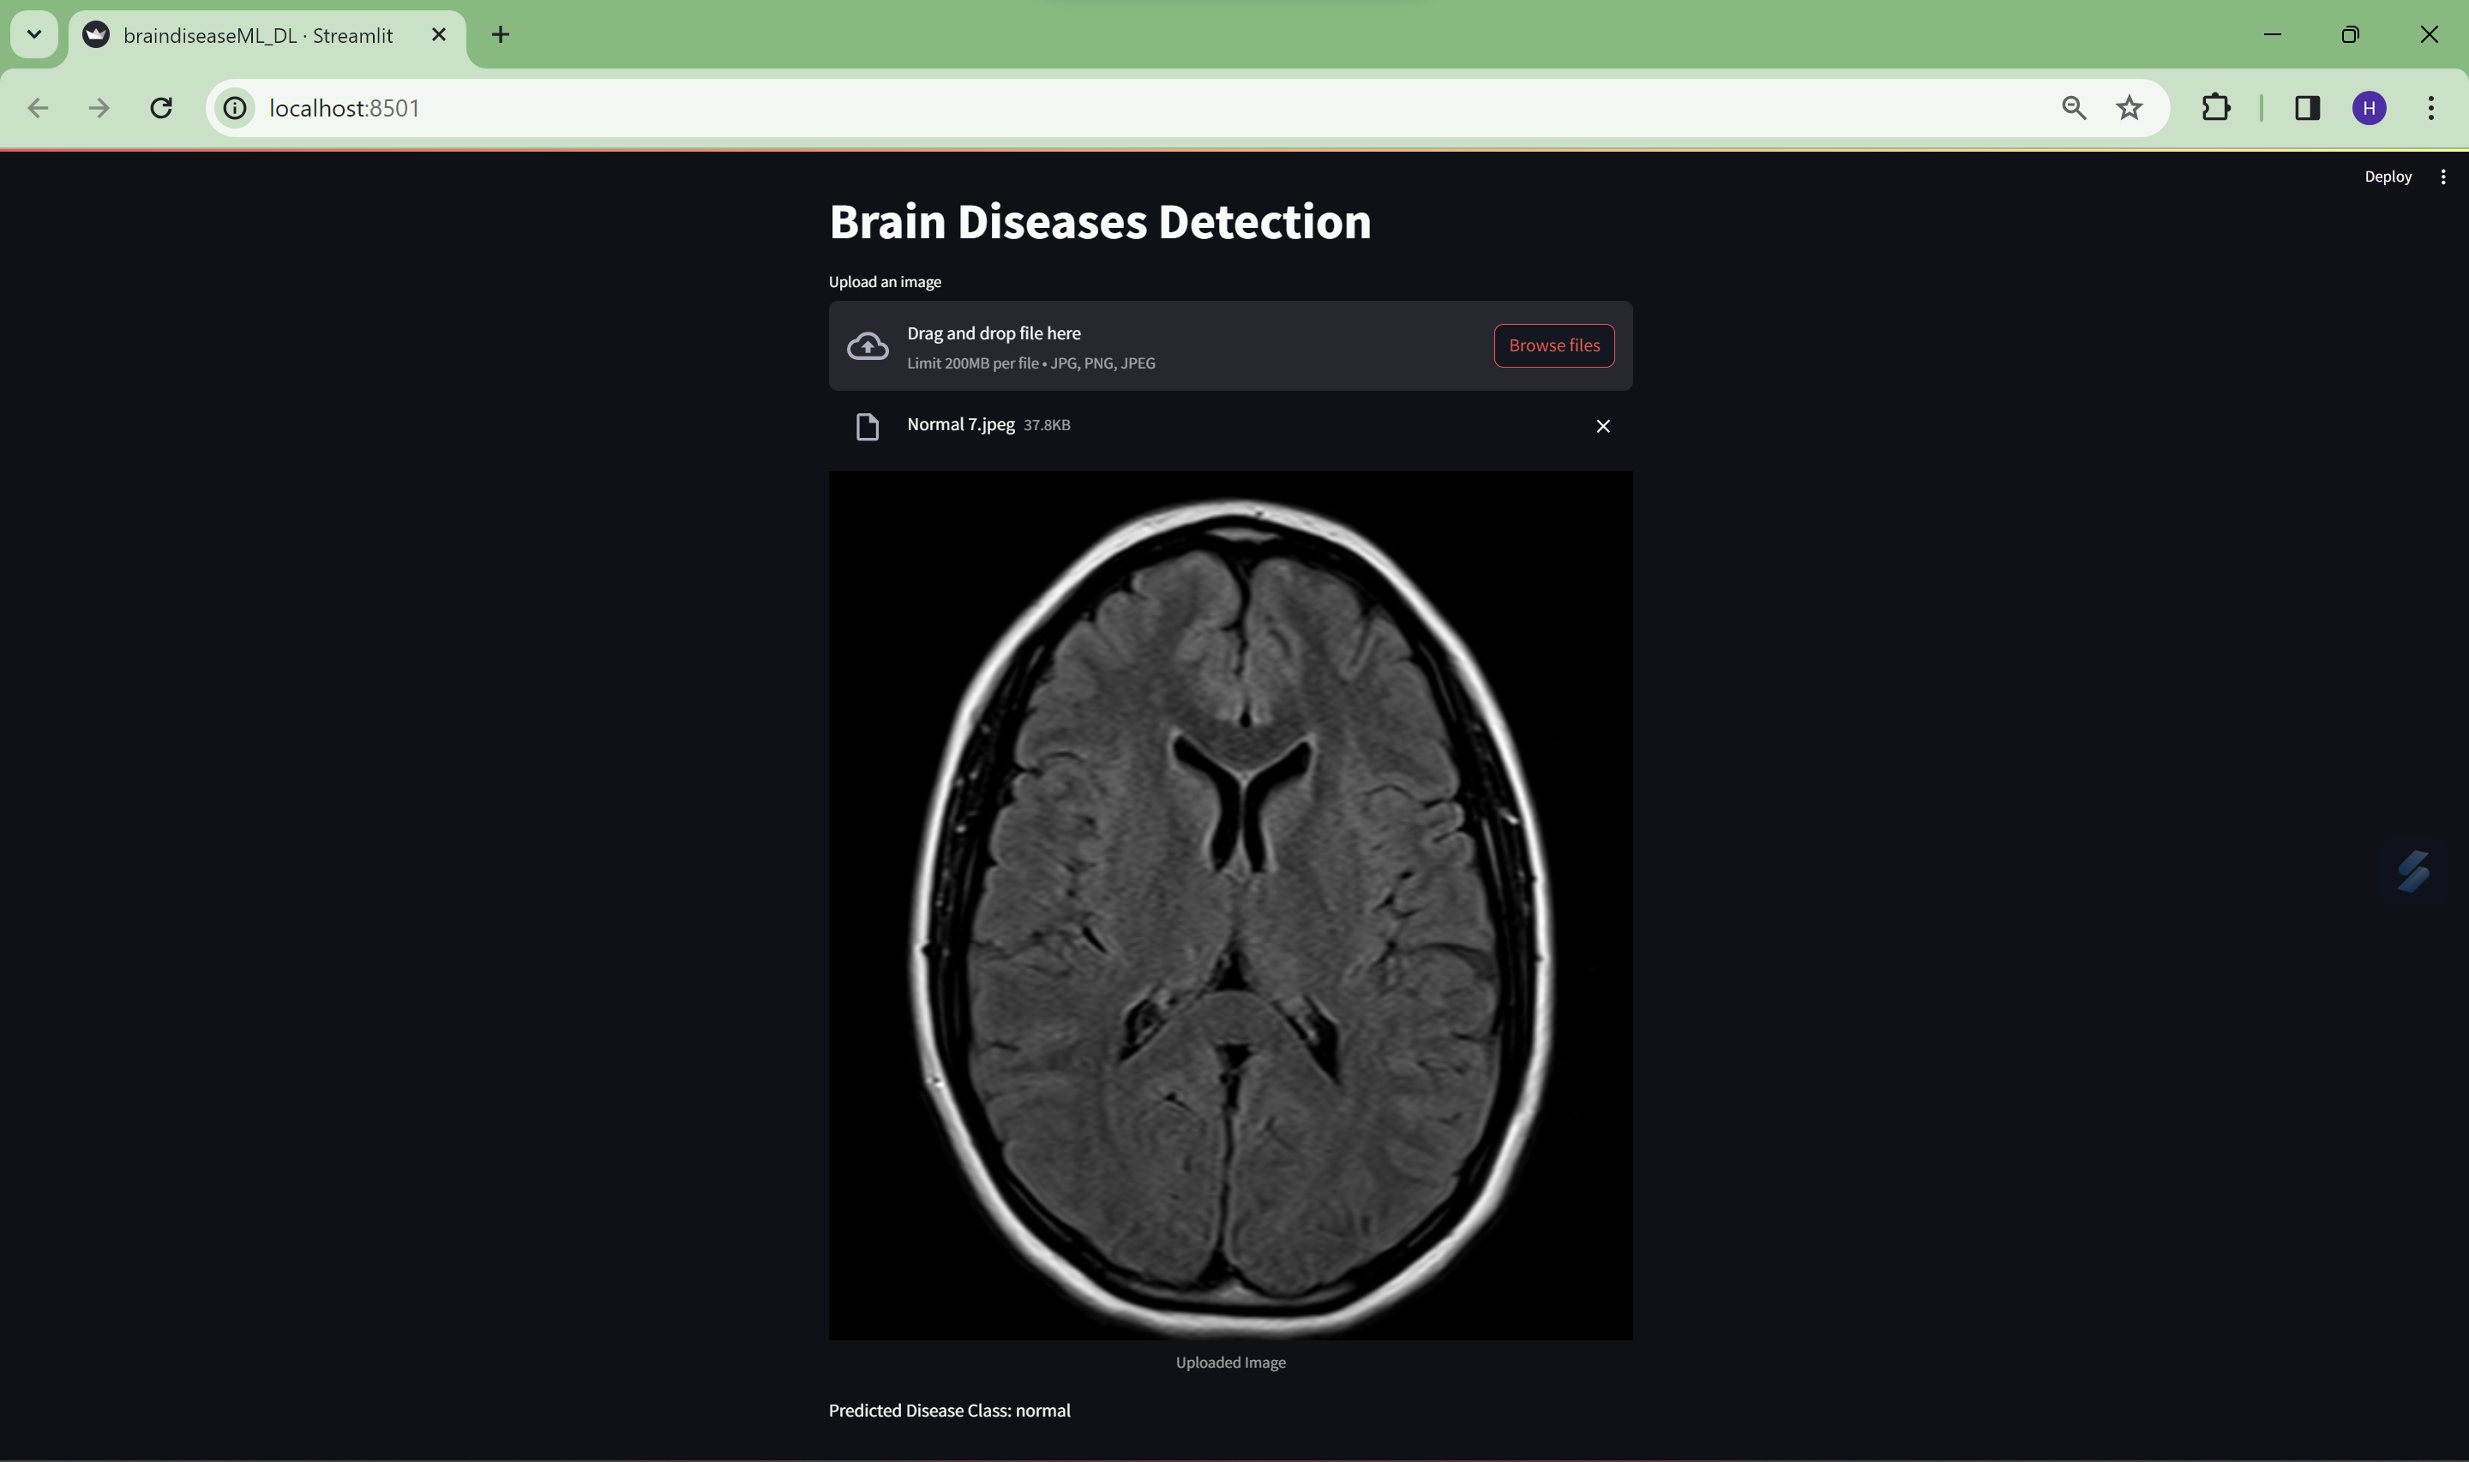
OUTPUT

Slide 24
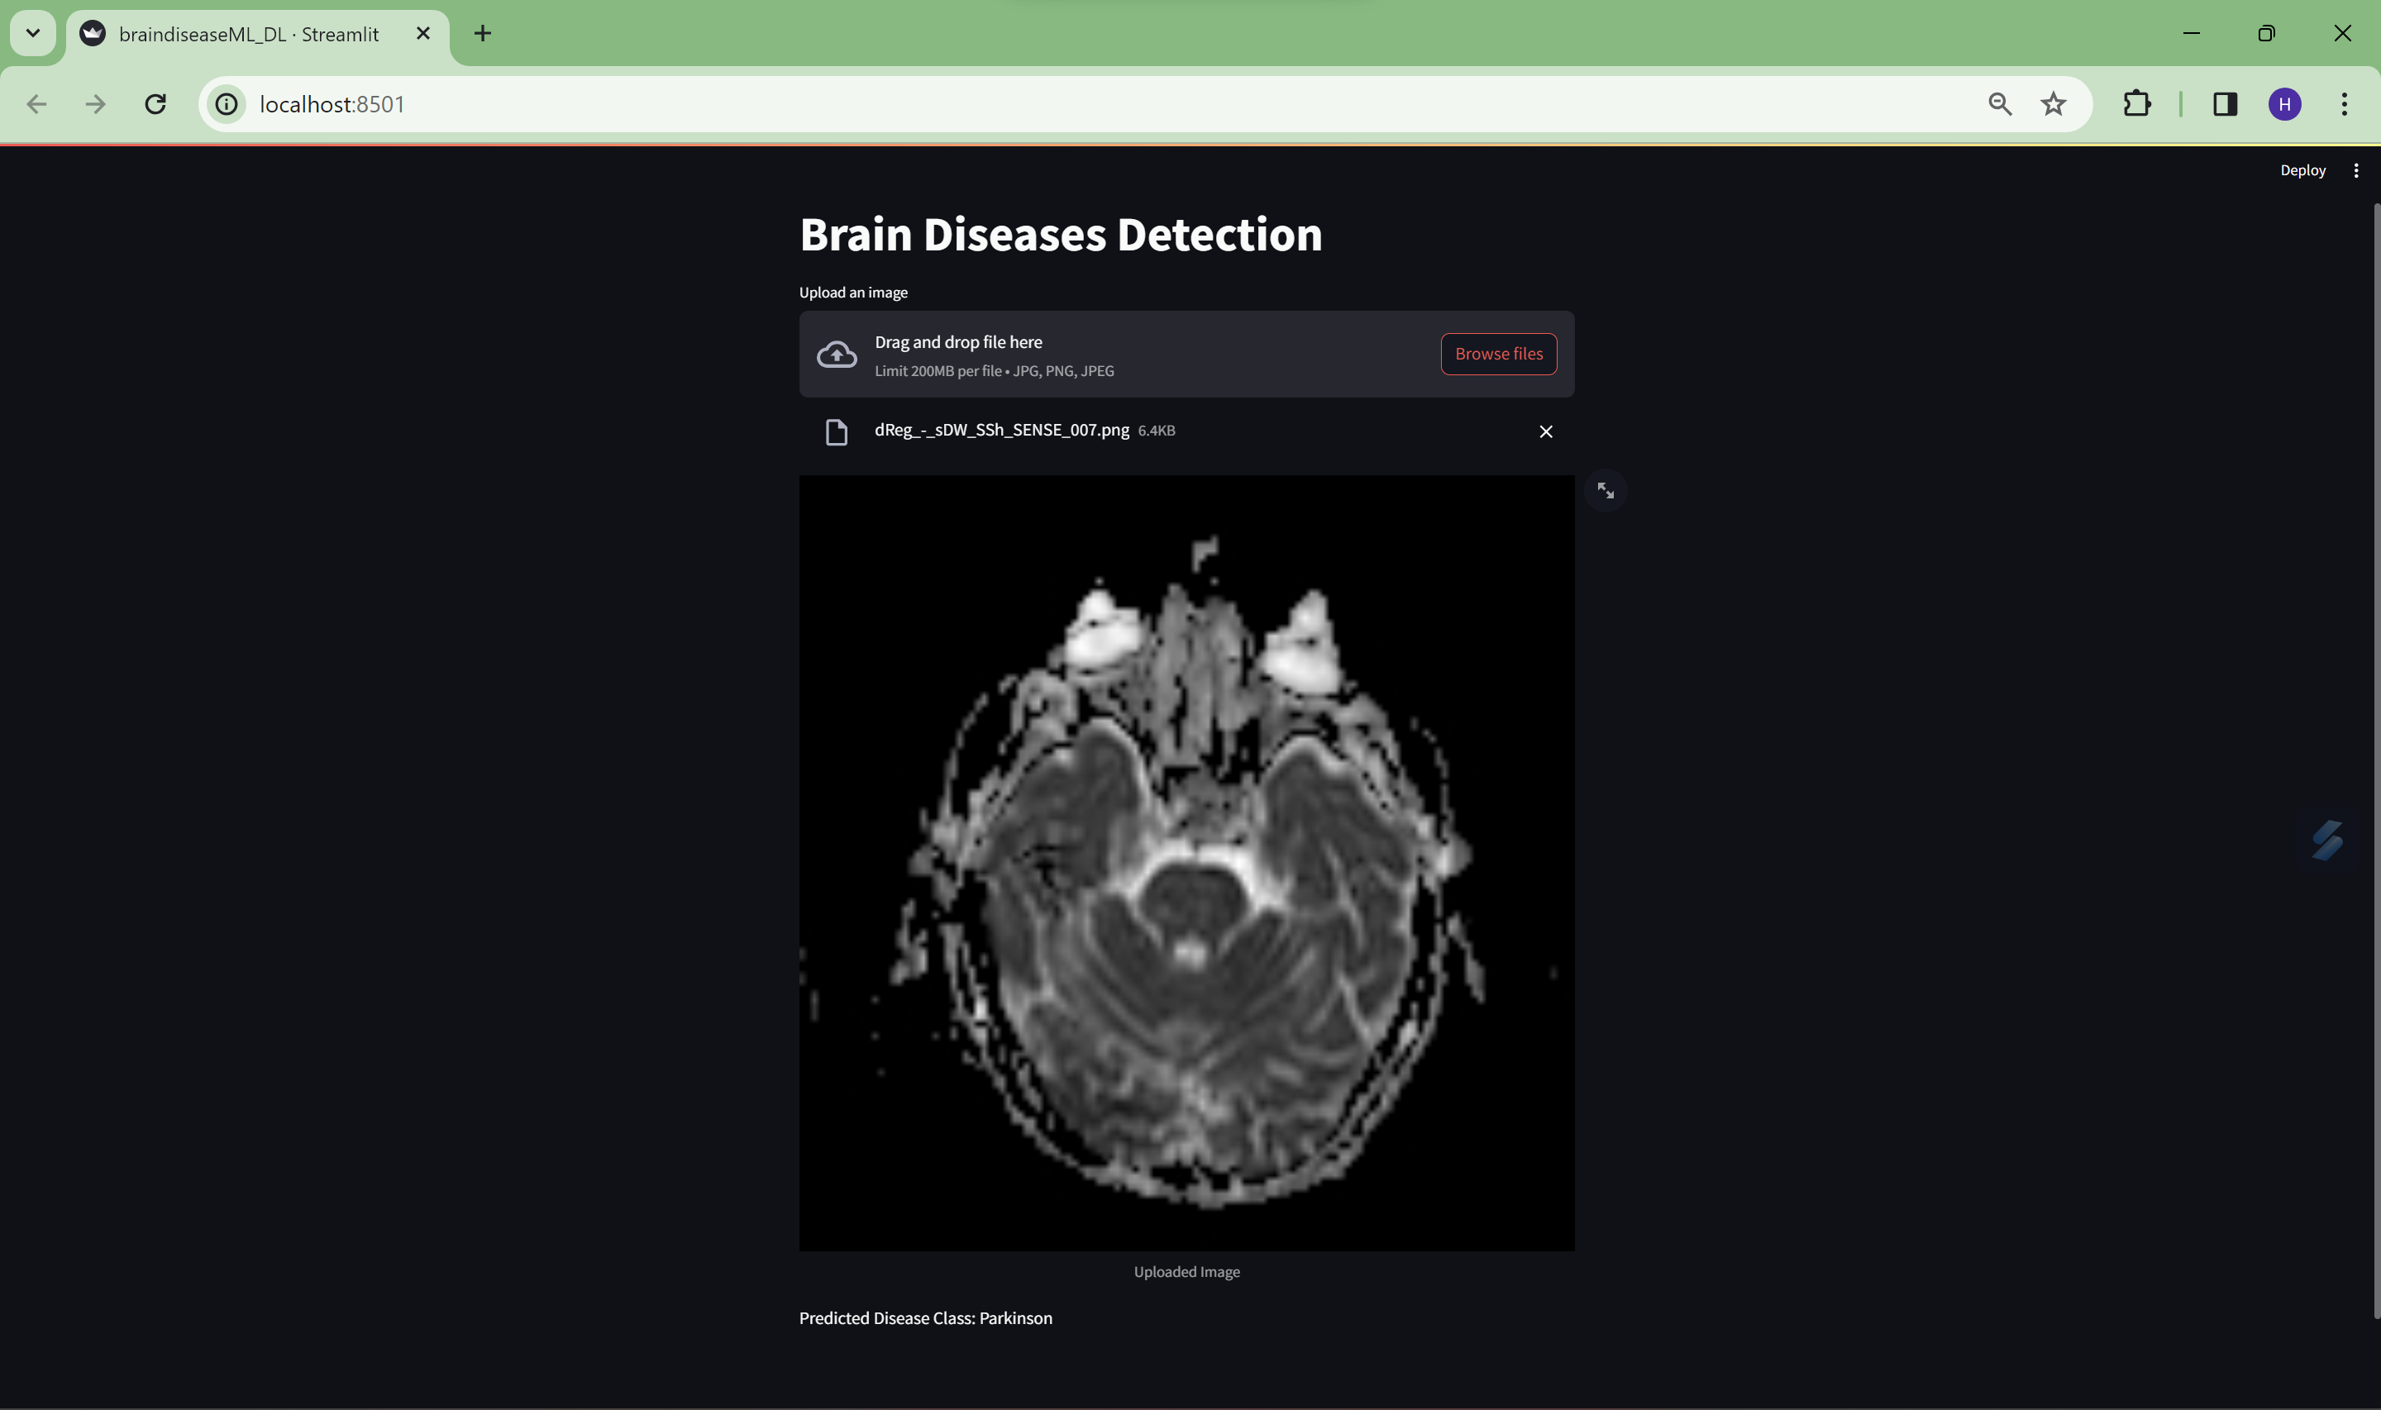
OUTPUT

Slide 25


